Slide 1
Digital Media Technology Week 4: Introduction to XSLT

Slide 2
Computer science needs the humanities to address some its central questions
For humanists, learning about computational methods can open up new perspectives

Slide 3
Have you ever studied a foreign language?
Do you play a musical instrument at any level of proficiency?
Have you ever read the manual of a new technical appliance that you have bought?
When your bike breaks, do you try to fix it yourself or call the shop?
Do you like to play chess? Or go? Or bridge? Any other difficult game?
Stephen Ramsay, Learning to Program

Slide 4


Slide 5
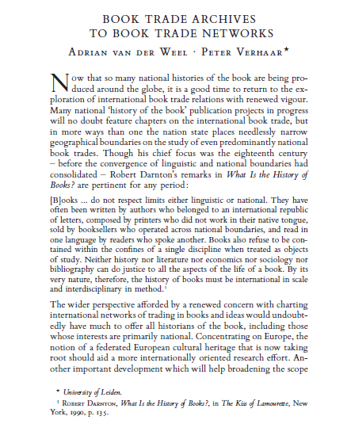
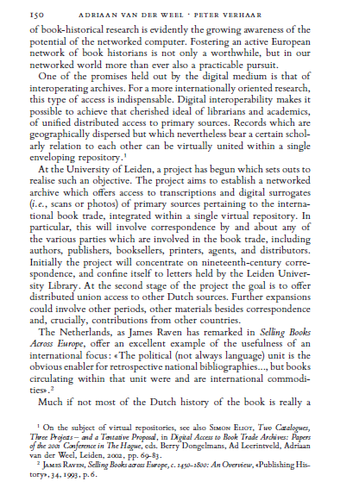
Logical structure

Slide 6
Information on semantic categories and on the logical structure can be made explicit through text encoding
<title>Booktrade Archives to Booktrade Networks</title>
<author>Adriaan van der Weel </author>
<p>Now that so many national histories of the book are being produced around the globe, it is a good time to return to the exploration of international book trade relations with renewed vigour. […] </p>
<quote>[B]ooks ... do not respect limits either linguistic or national. They have often been written by authors who belonged to an international republic of letters. […] </quote>

Slide 7
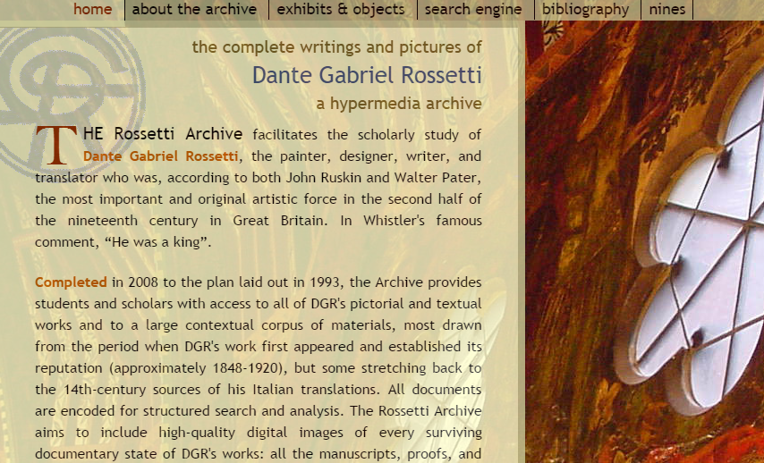
Using encoding as a filtering mechanism

Slide 8
The Waste Land by T.S. Eliot FOR EZRA POUND IL MIGLIOR FABBRO I. The Burial of the Dead April is the cruellest month, breeding Lilacs out of the dead land, mixing Memory and desire, stirring Dull roots with spring rain. Winter kept us warm, covering Earth in forgetful snow, feeding A little life with dried tubers. Summer surprised us, coming over the Starnbergersee With a shower of rain; we stopped in the colonnade, And went on in sunlight, into the Hofgarten, And drank coffee, and talked for an hour. Bin gar keine Russin, stamm’ aus Litauen, echt deutsch. And when we were children, staying at the arch-duke’s, My cousin’s, he took me out on a sled, And I was frightened.

Slide 9
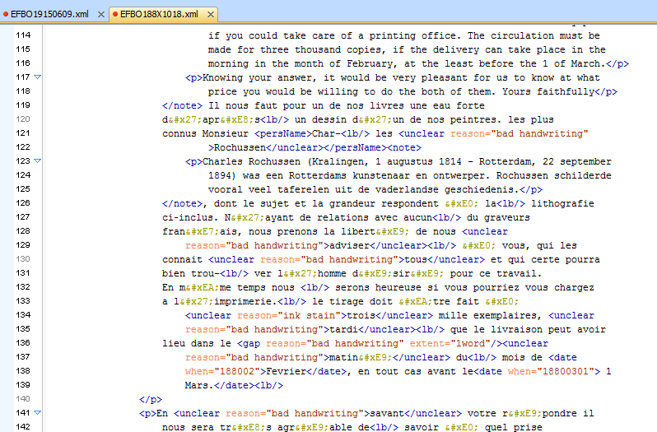
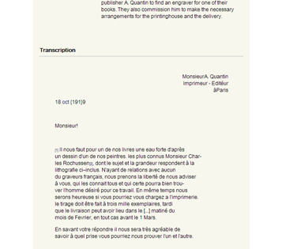
Stylesheet

Slide 10

Separation of form and content
Don McKenzie, Panizzi lecture, 1985
McKenzie emphasises a “process of material construction”
“each reading is peculiar to its occasion, each can be at least partially recovered from the physical forms of the text”

Slide 11
On analogue medium: form and contents are inseparable
On digital medium: fluidity of form
E.g. Steven J. DeRose et al., “What is Text, Really?”
Immaterial nature of digital information
Decrease in the importance of form as a more general development on digital media? Mp3-files, e-Books

Slide 12
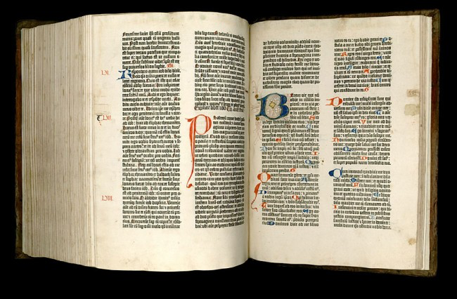

Slide 13
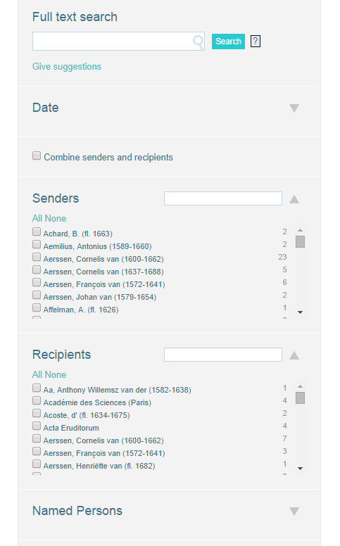
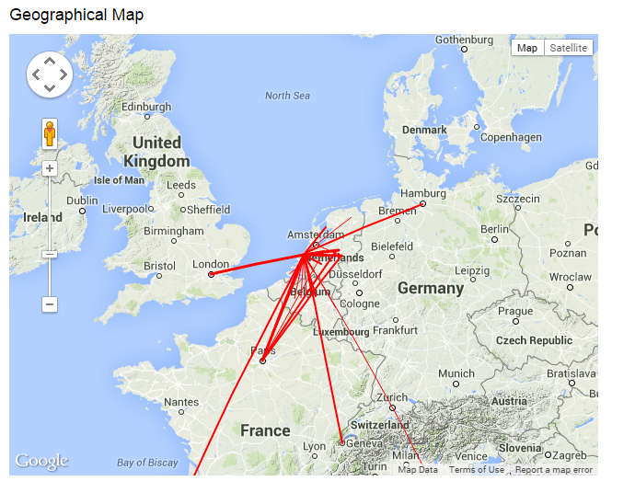
ePistolarium

Slide 14
Medium-neutrality
HTML
PDF
TEI
Stylesheet
MS Word
e.g. Single source publishing / XML Pooling
ePUB

Slide 15

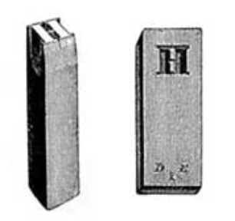
XSLT
eXtensible Stylesheet Language for Transformations
An XSLT Stylesheet contains a blueprint for the file to be created

Slide 16
XML Source
XSLT Stylesheet
XML Result

Slide 17
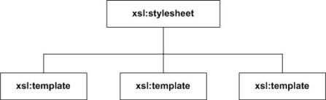
Tree diagram of an XSLT stylesheet

Slide 18
p {
color: red;
text-align: center;
}
h1 {
font-family: Arial, "Arial Unicode", Georgia, "Times New Roman", Times, serif;
color: #ecebeb;
font-size: 150%;
}
em {
font-style: italic;
font-weight: bold;
}

Slide 19
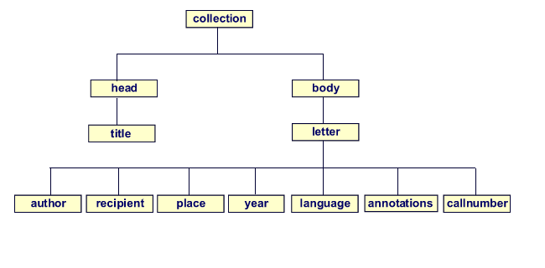
<xsl:stylesheet>
</xsl:stylesheet>
<xsl:template
match=“collection” > </xsl:template>
<xsl:template match=“letter” > </xsl:template>

Slide 20
Getting started
Analyse the XML source: draw a tree diagram
Create a basic XSLT stylesheet (xsl:stylesheet root and one xsl:template)
The match-attribute of the first template must point to the root of the XML source
In this first template, create a basic HTML page

Slide 21
Example: XML source
<?xml version="1.0" encoding="UTF-8"?>
<letter>
<head>Letter from De Erven F. Bohn to W. Blackwood and sons, January 22nd, 1873</head>
<body>
<dateline>
<place>Haarlem</place>
<date>22 January 1873</date>
</dateline>
<greeting>Dear Sirs!</greeting>
<p>We beg to apply to you the kind request for sending us one week before the publication one copy of Bulwer&apos;s novel: <title>Kenelm Chillingly, His adventures and opinions</title>, which book you have in the press, for what we are inclined to pay 30 £. When it were possible to send us already now the first volume by the post; it would be yet more agreeable. Mr H.A. Kramers at Rotterdam readily will be our pledge.</p>
<salute> your truly</salute>
<signed>De Erven F. Bohn</signed>
</body>
</letter>

Slide 22
Include a template that points to the root element of the XML source.
XML
XSLT
<?xml version="1.0" encoding="UTF-8"?>
<letter>
<head>Letter from De Erven F. Bohn to W. Blackwood and sons, January 22nd, 1873</head>
<body>
…. </body>
</letter>
<xsl:template match=“letter"> … </xsl:template>

Slide 23
XSLT
XML Source
<?xml version="1.0" encoding="UTF-8"?>
<xsl:stylesheet xmlns:xsl="http://www.w3.org/1999/XSL/ Transform" version="1.0">
<xsl:template match="letter">
</xsl:template>
</xsl:stylesheet>
<?xml version="1.0" encoding="UTF-8"?>
<letter>
…
</letter>
XML Result

Slide 24
TEI
<titleStmt><title>Letter from De Erven F. Bohn to George Eliot</title></titleStmt>
<xsl:template>
<html>
<head></head>
<body>
<h1>
<xsl:value-of select=“titleStmt/title”/>
</h1>
</body>
</htlml>
</xsl:template>
XSLT

Slide 25
HTML Result file
<html>
<head></head>
<body>
<h1>Letter from De Erven F. Bohn to George Eliot</h1>
</body>
</htlml>

Slide 26
TEI
<titleStmt><title>Letter from De Erven F. Bohn to George Eliot</title></titleStmt>
<xsl:template>
<html>
<head></head>
<body>
<h1>Letter from De Erven F. Bohn to George Eliot</h1>
</body>
</htlml>
</xsl:template>
XSLT

